Slide 1
CHATBOT
1.Sajid Ahmed Chowdhury
2.Sadia Alam
3.Shaikh Faiyaz Karim

Slide 2


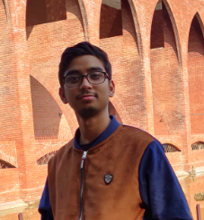
TEAM
Sadia Alam
Shaikh Faiyaz
Karim
Sajid Ahmed
Chowdhury

Slide 3
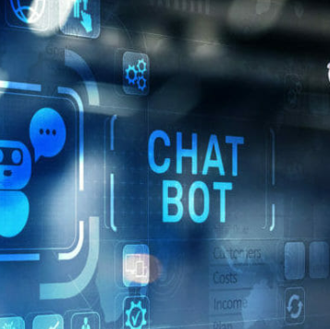
Introduction
Translating the word “Pera” from the Global Italian-English Dictionary we get the meaning “To be easily fooled”. So our Chatterbot NOPERA is a bot that is not easily fooled.
In our project we have decided to create a chatterbot with cognitive abilities.

Slide 4
Features added
We introduced keywords that will be in our database which the bot will recognize and set a response to that specific keyword.
Various events like NULL input, NULL input repetition, User input repetition, bot not understanding etc. will trigger certain special responses.
Our Bot will have the ability to take certain part of the input as the template and transpose the pronoun to generate response. It will also have the ability understand context
Our Bot is no DUMB bot. It will talk to you if you are nice enough ☺
All the inputs and their responses are saved in a text file with timestamps.
Furthermore, the bot has the ability to inform the developer of its shortcomings so that It can learn from it.
Keywords
Event Handling
Template & Context
Text to Speech
Saving log and learning ability

Slide 5
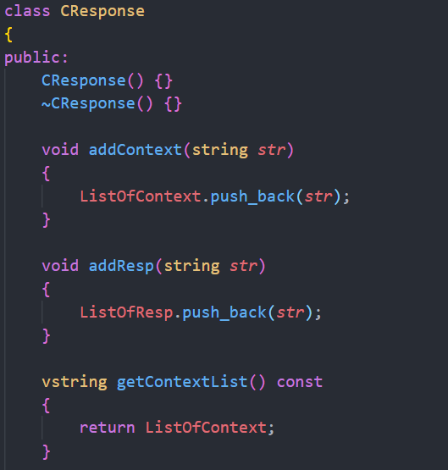
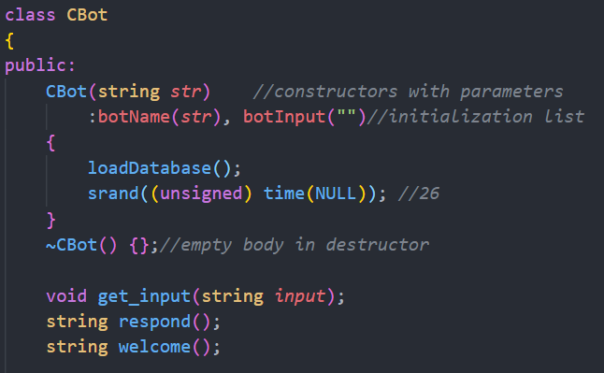
Classes

Slide 6
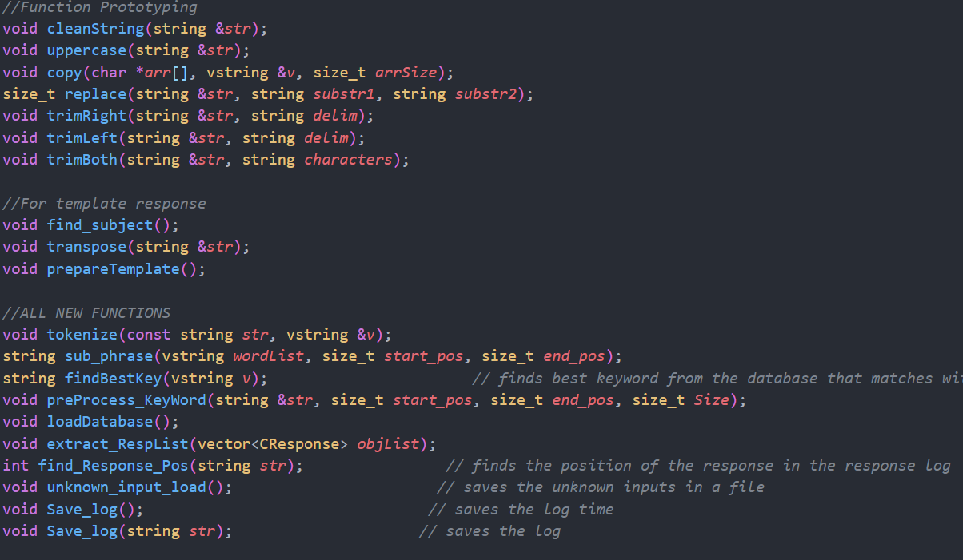
classes

Slide 7
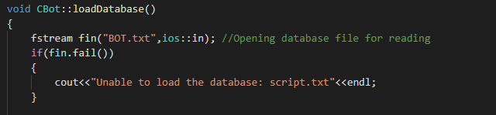
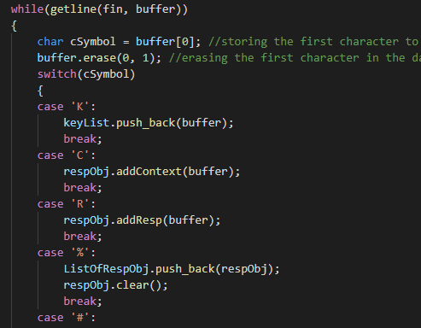
LOADING THE DATABASE
Subtitle
We load the database from the text file and then set it apart based on the cases as presented:
K → keyword
C → Context
R → Responses
# → Next set

Slide 8
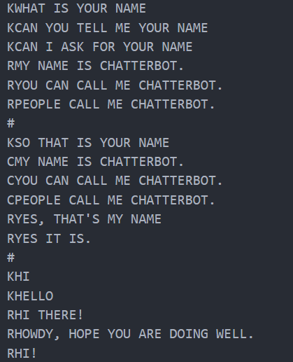
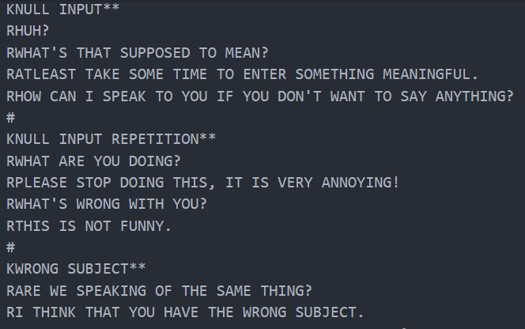
DataBase

Slide 9
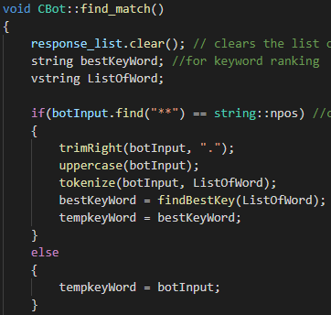
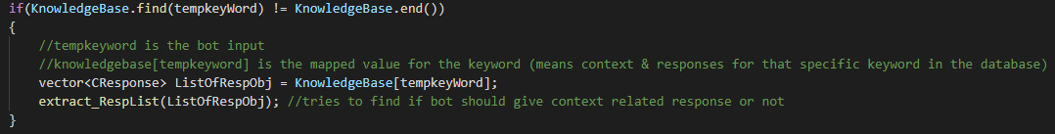
FINDING MATCH FOR THE KEYWORDS
We will perform all the mentioned functions to find the response for the keyword. Various event are also handled in the process.

Slide 10
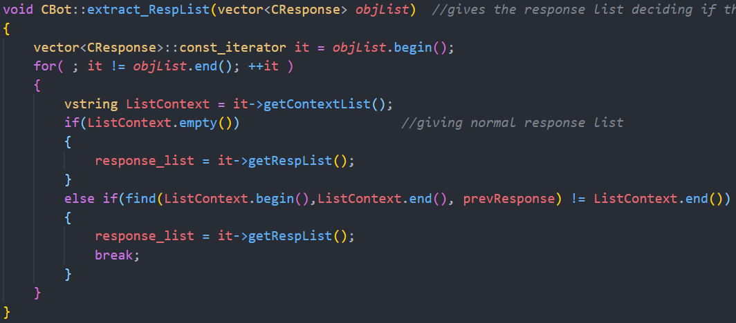
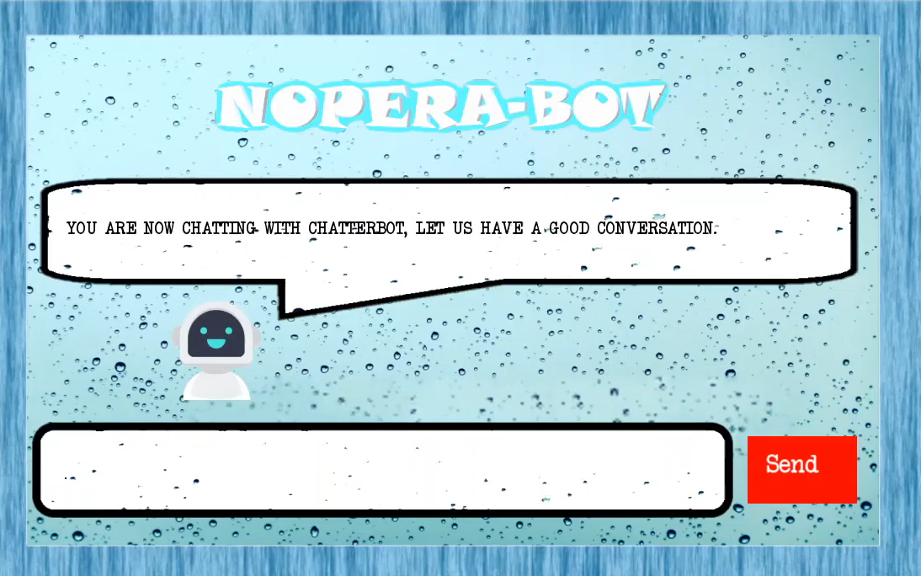
Context Handling
The bot is able to recognize context. Like if you talk about a topic and then ask a follow up question without mentioning the specifics of the topic it will understand it.

Slide 11
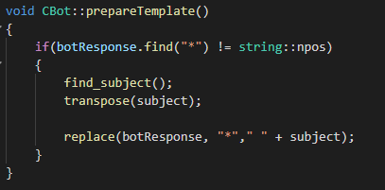
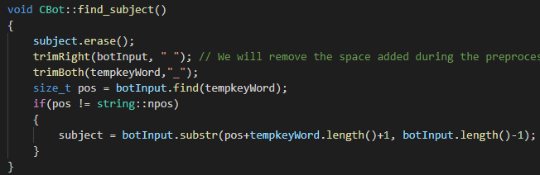
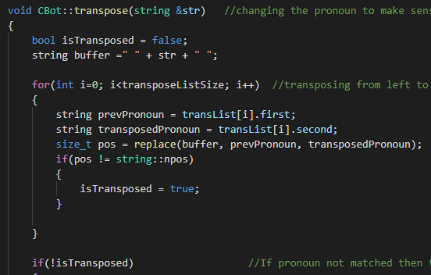
Transpose and Template response
In Template response we will first find the subject by finding the position of the temporary keyword.
Then we will transpose the pronoun to make sense of the response and hence generate the template output.

Slide 12
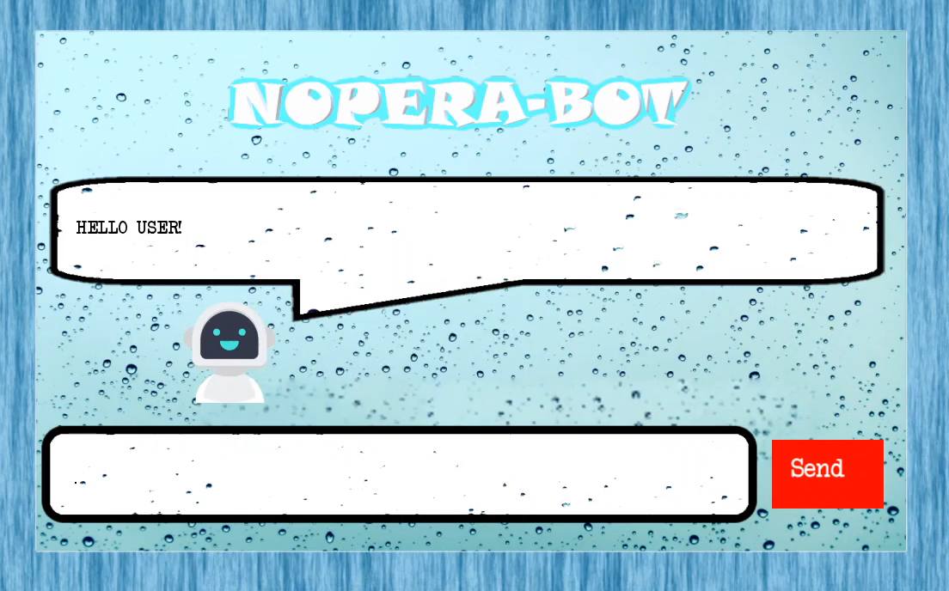
Transpose and Template response

Slide 13
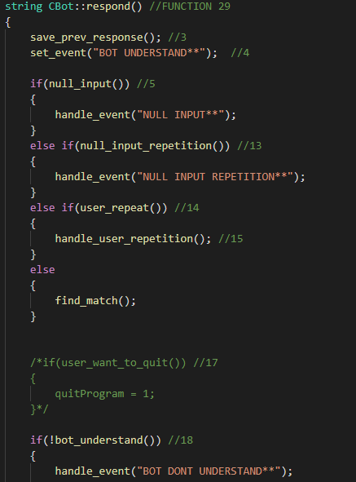
Handling EVENTS
The keywords are set for certain events and in each cases there are specific actions to be performed.
All these actions are performed by a function called handle_event

Slide 14
Graphical User Interface

Slide 15
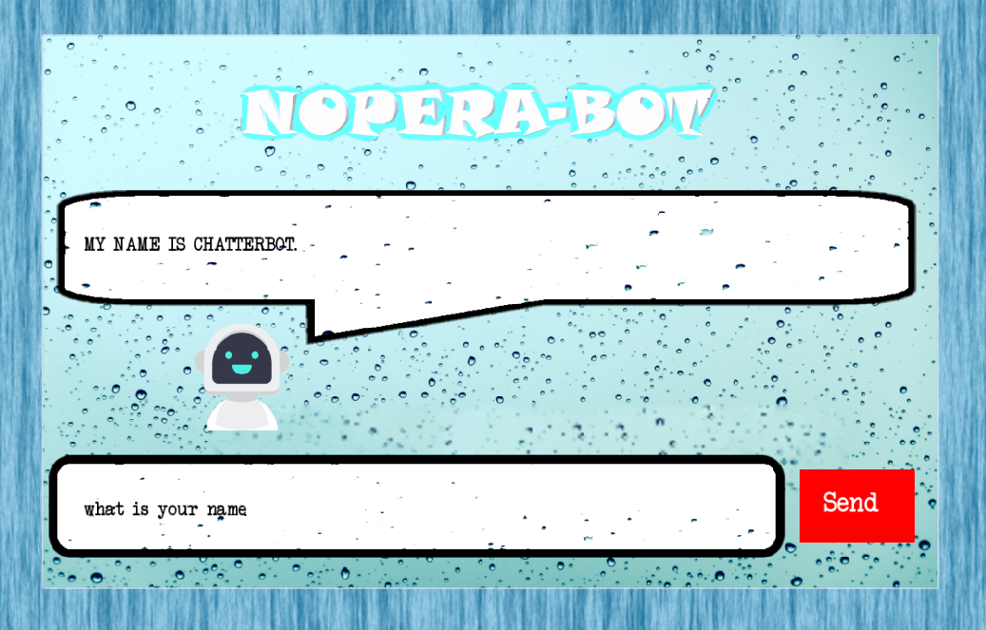

Slide 16
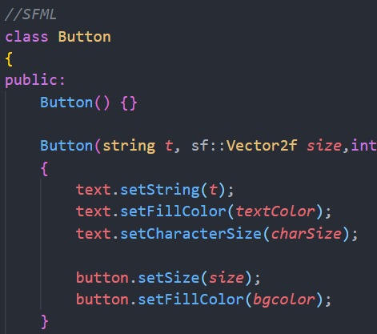
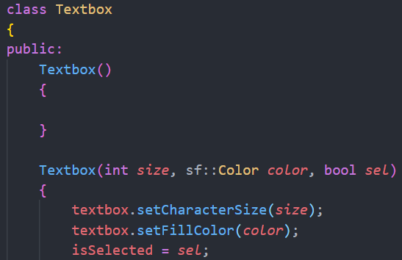
Graphical User Interface
We Used SFML to create the GUI

Slide 17
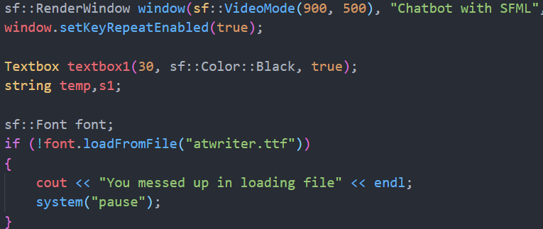
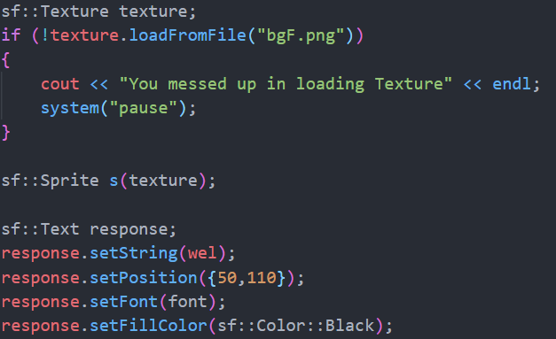
Graphical User Interface

Slide 18
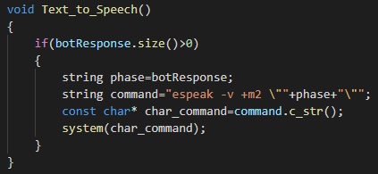
Text to Speech
Our Bot is no DUMB bot. It will talk to you if you are nice enough ☺
To add this feature we used the API eSpeak.
eSpeak uses a "formant synthesis" method. This allows many languages to be provided in a small size. The speech is clear, and can be used at high speeds, but is not as natural or smooth as larger synthesizers which are based on human speech recordings.

Slide 19
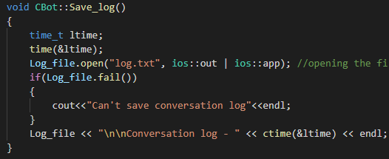
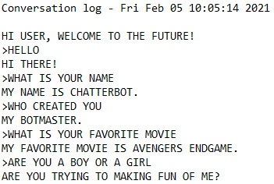
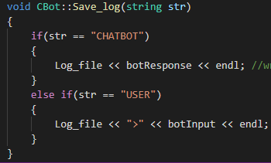
Saving Conversation log
We will save the conversion between the user and the bot in a separate text file along with the time log. E.g.

Slide 20
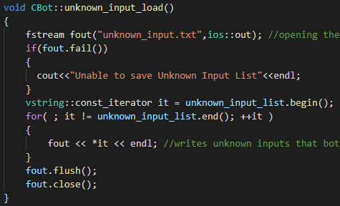
Learning Capability
When the program quits then all the inputs the bot could not understand will be saved in a separate file where the developers can mend their mistakes.

Slide 21
Main Window Loop

Slide 22
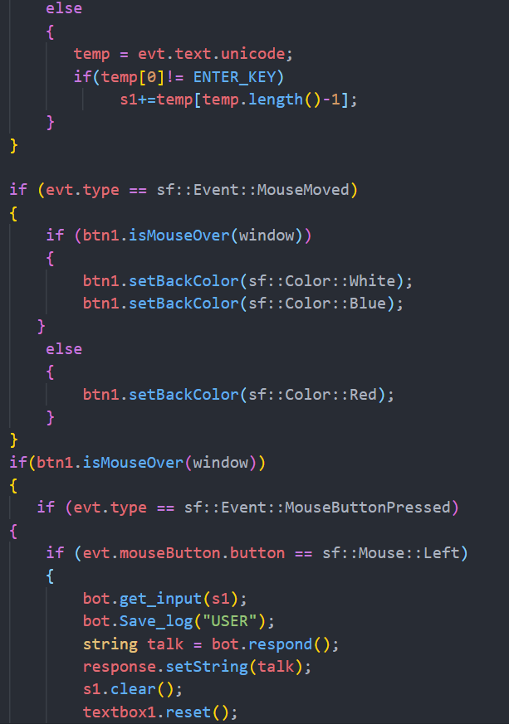
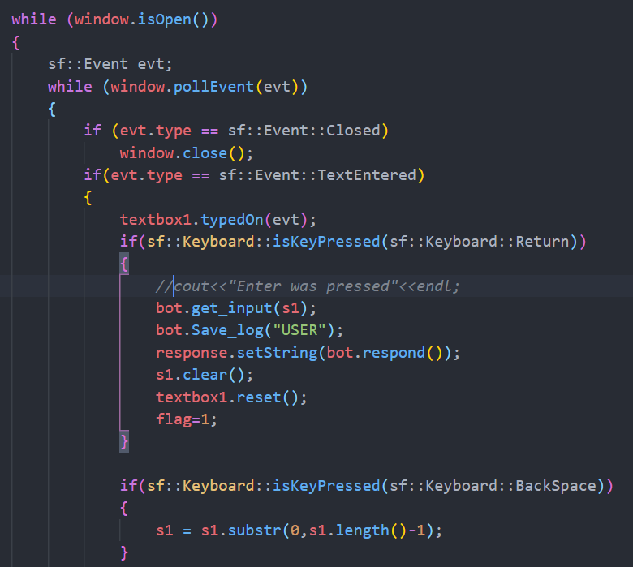

Slide 23
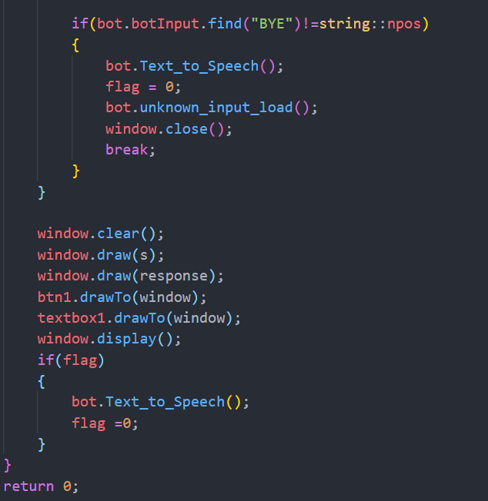

Slide 24
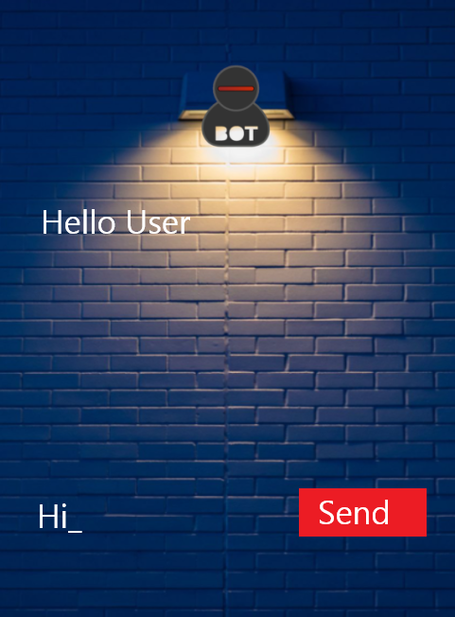
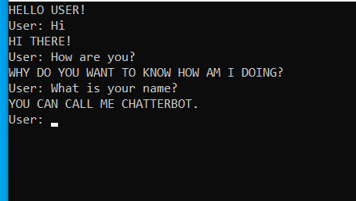

Summary
To be honest, this project was a good learning experience for all of us. There were many ups, as well as many downs. But all of these will help us to become better programmers in the future hopefully. The nights spent together on discord pulling our hairs over the code were especially memorable. We hope everything came together to present you guys with a project we could be proud of.

Slide 25




THANK YOU
Sajid, Faiyaz and Sadia

